Slide 1
Health and Safety Unit 6223
Unit aim
Unit aims: This unit aims to help learners to acquire and apply Health and Safety working practices in the context of Design and Technology work.
Name:

Slide 2
Workshop Rules
Objective 1. Know about hazard or risks in the workshop environment |  |  | Workshop rules
Candidate Name | Candidate Number | AC1.1 (E2/E3) |  | Page Number
List of workshop rules
http://www.technologystudent.com/health1/ed1.htm
Why do we have these rules?
Notes:
AC1.1 Identify workshop areas where there may be hazard or risk. (Entry 2)

Slide 3
Workshop Rules
Objective 1. Know about hazard or risks in the workshop environment |  |  | Workshop rules
Candidate Name | Candidate Number | AC1.1 (E2/E3) |  | Page Number
List of workshop rules
__________________________________
__________________________________
__________________________________
__________________________________
__________________________________
__________________________________
We have these rules to ……….
Notes:
AC1.1 Identify workshop areas where there may be hazard or risk. (Entry 2)

Slide 4
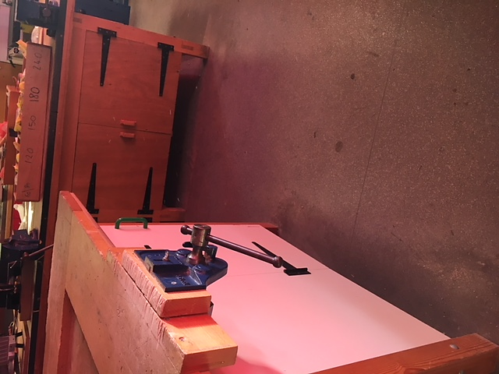
Objective 1. Know about hazard or risks in the workshop environment |  |  | Hazards / risks in the workshop
Candidate Name | Candidate Number | AC1.1 (E2/E3) |  | Page Number
AC1.1 Identify workshop areas where there may be hazard or risk. (Entry 2) AC1.1 Explain why there may be a hazard or risk in specific workshop areas. (Entry 3)
Photo of the workshop
Label areas that could be a hazard, and explain why.
This is a hazed because you can easily walk into them if your not looking
Notes:
AC1.1 Identify workshop areas where there may be hazard or risk. (Entry 2)
AC1.1 Explain why there may be a hazard or risk in specific workshop areas. (Entry 3)

Slide 5
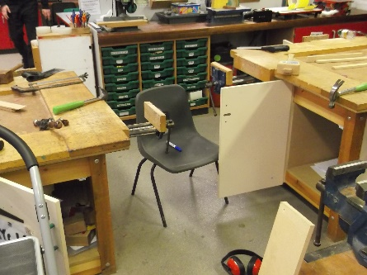
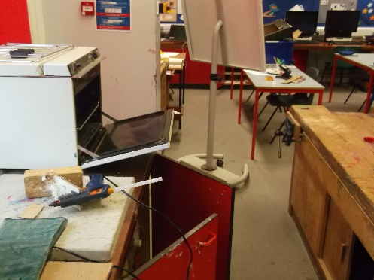
AC1.1 Identify workshop areas where there may be hazard or risk. (Entry 2) AC1.1 Explain why there may be a hazard or risk in specific workshop areas. (Entry 3)
Objective 1. Know about hazard or risks in the workshop environment
Candidate Name | Candidate Number | AC1.1 (E2/E3) |  | Page Number
Notes:
AC1.1 Identify workshop areas where there may be hazard or risk. (Entry 2)

Slide 6
AC1.1 Identify workshop areas where there may be hazard or risk. (Entry 2) AC1.1 Explain why there may be a hazard or risk in specific workshop areas. (Entry 3)
Objective 1. Know about hazard or risks in the workshop environment
Candidate Name | Candidate Number | AC1.1 (E2/E3) |  | Page Number
Notes:
AC1.1 Identify workshop areas where there may be hazard or risk. (Entry 2)

Slide 7
Symbols we find in the workshop
Objective 1. Know about hazard or risks in the workshop environment |  |  | Health & Safety Symbols
Candidate Name | Candidate Number | AC1.4 (E2/E3) |  | Page Number
Label what the symbol means
Notes:
AC1.4 Identify Health and Safety symbols and diagrams. (Entry 2)
AC1.4 Explain Health and Safety symbols and diagrams. (Entry 3)

Slide 8
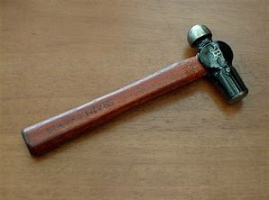
Objective 1. Know about hazard or risks in the workshop environment Objective 2. Be able to apply health and safety practices Picture of tool / equipmen What safety rules do you follow? Why? Do you need to wear goggles? Why? Do you need to tie your hair up? Why?
Objective 1. Know about hazard or risks in the workshop environment Objective 2. Be able to apply health and safety practices |  | Hazards / risks when using tools/machines Selecting the correct tools/machines, use in the correct manner.
Candidate Name | Candidate Number |  | Objective 1 & 2 | Page Number
Hammer
Go slowly, or you could slip & hit your finger.
Make sure no one is near you or you could hit them & they will get hurt.
Hold the hammer tight or you could let go & hit yourself. You will get hurt.
Notes:
AC1.2 Identify where there may be hazard or risk when using general tools such as hand tools. (Entry 2)
AC1.2 Explain why there may be a hazard or risk when using general tools such as hand tools. (Entry 3)
AC2.1 Select the correct tool(s) for a particular process of making. (Entry 2 & 3)
AC2.2 Use equipment correctly under guidance when making products. (Entry 2)
AC2.2 Select the correct equipment for making the product in the correct manner. (Entry 3

Slide 9
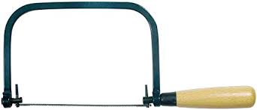
Coping saw picture Coping saw safety rules Use of Coping Saw
Objective 1. Know about hazard or risks in the workshop environment Objective 2. Be able to apply health and safety practices |  |  | Hazards / risks when using tools/machines Selecting the correct tools/machines, use in the correct manner.
Candidate Name | Candidate Number | AC1.2 (E2/E3) AC2.1 (E2/E3) AC2.2 (E2/E3) |  | Page Number
Notes:
AC1.2 Identify where there may be hazard or risk when using general tools such as hand tools. (Entry 2)
AC1.2 Explain why there may be a hazard or risk when using general tools such as hand tools. (Entry 3)
AC2.1 Select the correct tool(s) for a particular process of making. (Entry 2 & 3)
AC2.2 Use equipment correctly under guidance when making products. (Entry 2)
AC2.2 Select the correct equipment for making the product in the correct manner. (Entry 3

Slide 10
Tenon saw picture Tenon saw safety rules Use of Tenon Saw
Objective 1. Know about hazard or risks in the workshop environment Objective 2. Be able to apply health and safety practices |  |  | Hazards / risks when using tools/machines Selecting the correct tools/machines, use in the correct manner.
Candidate Name | Candidate Number | AC1.2 (E2/E3) AC2.1 (E2/E3) AC2.2 (E2/E3) |  | Page Number
Notes:
AC1.2 Identify where there may be hazard or risk when using general tools such as hand tools. (Entry 2)
AC1.2 Explain why there may be a hazard or risk when using general tools such as hand tools. (Entry 3)
AC2.1 Select the correct tool(s) for a particular process of making. (Entry 2 & 3)
AC2.2 Use equipment correctly under guidance when making products. (Entry 2)
AC2.2 Select the correct equipment for making the product in the correct manner. (Entry 3

Slide 11
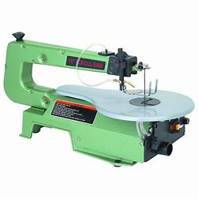
Scroll saw picture Scroll saw rules Use of Scroll saw
Objective 1. Know about hazard or risks in the workshop environment Objective 2. Be able to apply health and safety practices |  | Hazards / risks when using tools/machines Selecting the correct tools/machines, use in the correct manner.
Candidate Name | Candidate Number | AC1.3 (E2/E3) AC2.3 (E2/E3) | Page Number
Notes:
AC1.3 Identify where there may be hazard or risk when using general tools such as hand tools. (Entry 2)
AC1.3 Explain why there may be a hazard or risk when using general tools such as hand tools. (Entry 3)
AC2.3 Use general workshop machinery under guidance. (Entry 2)
AC2.3 Use general workshop machinery with limited guidance. (Entry 3)

Slide 12
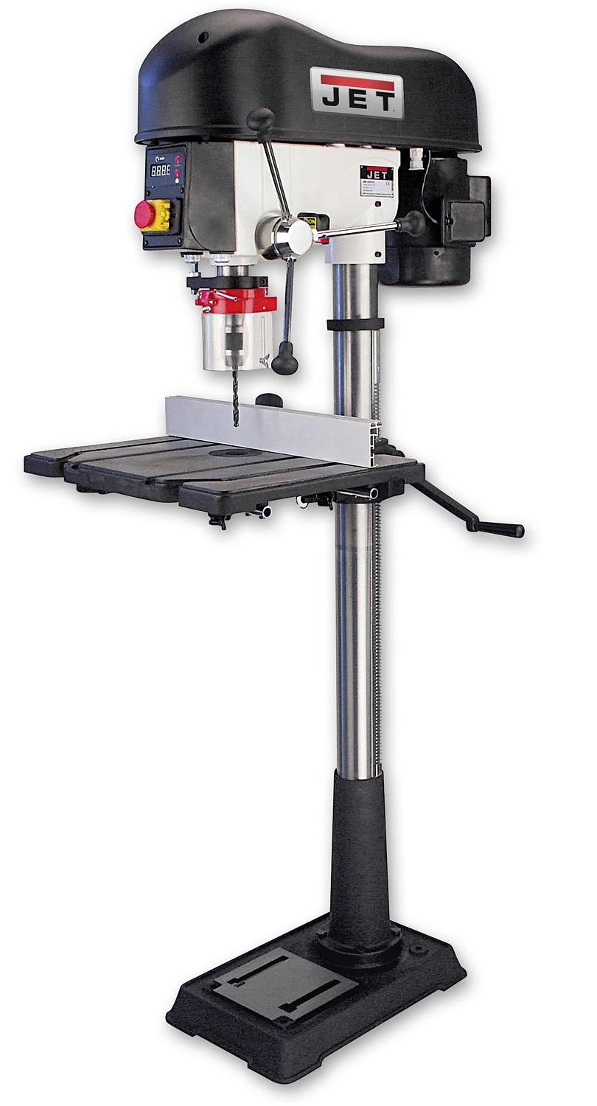
Pillar drill picture Pillar drill safety rules Use of pillar drill
Objective 1. Know about hazard or risks in the workshop environment Objective 2. Be able to apply health and safety practices |  | Hazards / risks when using tools/machines Selecting the correct tools/machines, use in the correct manner.
Candidate Name | Candidate Number | AC1.3 (E2/E3) AC2.3 (E2/E3) | Page Number
Notes:
AC1.3 Identify where there may be hazard or risk when using general tools such as hand tools. (Entry 2)
AC1.3 Explain why there may be a hazard or risk when using general tools such as hand tools. (Entry 3)
AC2.3 Use general workshop machinery under guidance. (Entry 2)
AC2.3 Use general workshop machinery with limited guidance. (Entry 3)

Slide 13
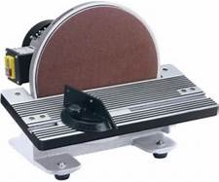
Disc Sander picture Disc Sander safety rules Use of Disc Sander
Objective 1. Know about hazard or risks in the workshop environment Objective 2. Be able to apply health and safety practices |  | Hazards / risks when using tools/machines Selecting the correct tools/machines, use in the correct manner.
Candidate Name | Candidate Number | AC1.3 (E2/E3) AC2.3 (E2/E3) | Page Number
Notes:
AC1.3 Identify where there may be hazard or risk when using general tools such as hand tools. (Entry 2)
AC1.3 Explain why there may be a hazard or risk when using general tools such as hand tools. (Entry 3)
AC2.3 Use general workshop machinery under guidance. (Entry 2)
AC2.3 Use general workshop machinery with limited guidance. (Entry 3)

