Slide 1
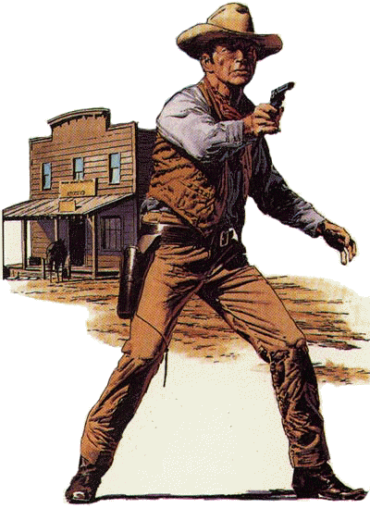
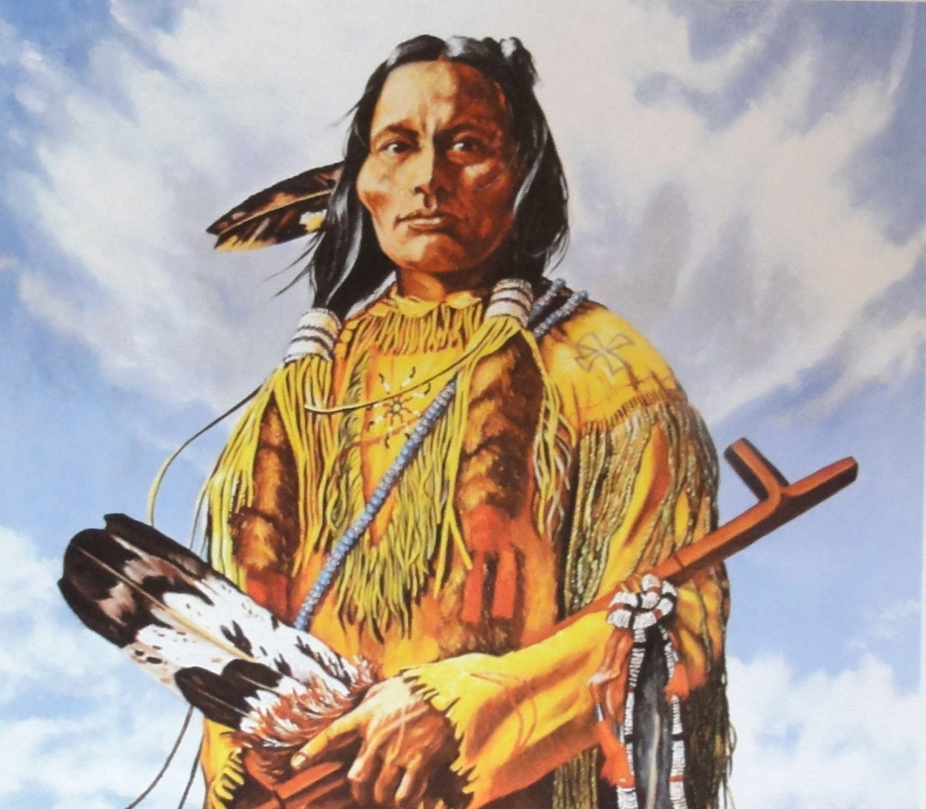
L/O: to compare the Native Americans to the Cowboys

Slide 2
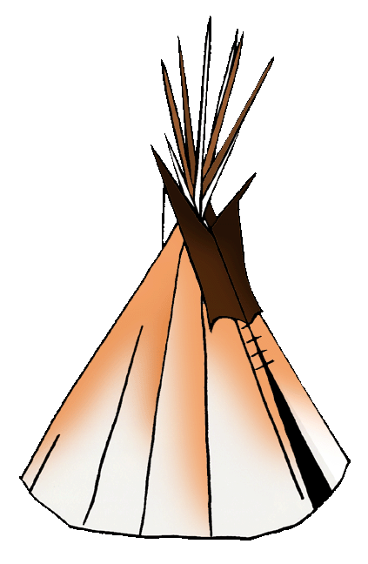
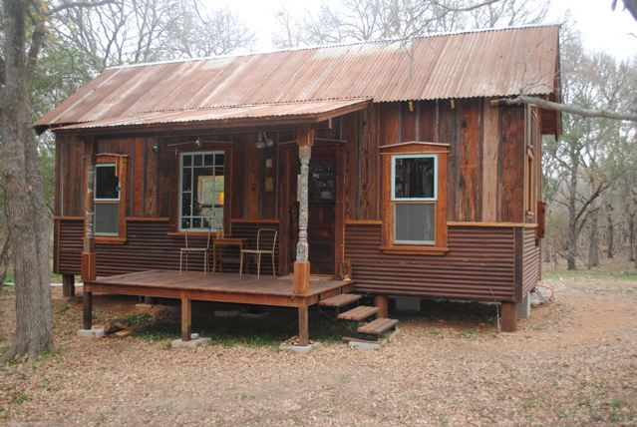
The homes that Native Americans and cowboys lived in were very different

Slide 3
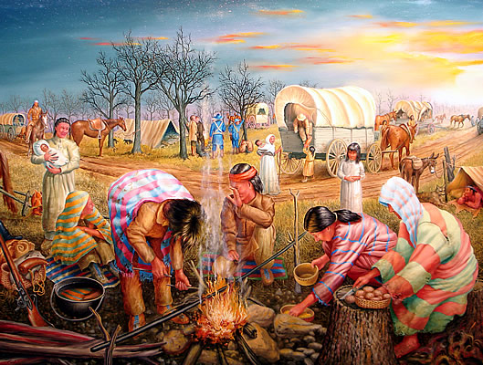
The Native Americans lived together as a tribe led by a chief

Slide 4
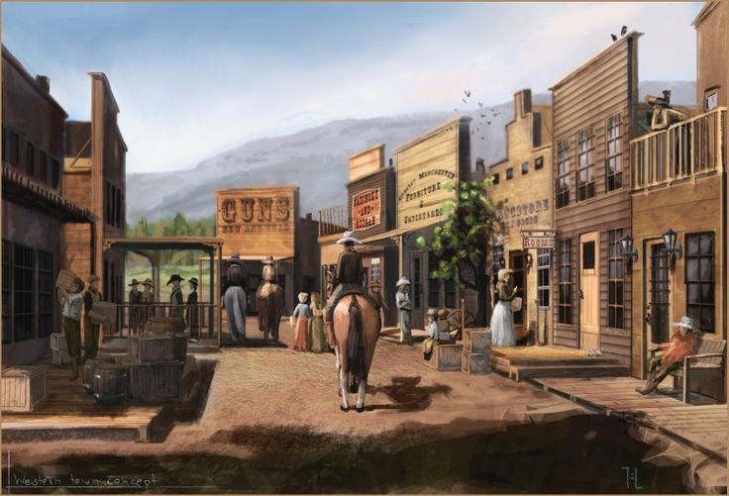
A town in the ‘Wild West’ – cowboys lived here

Slide 5
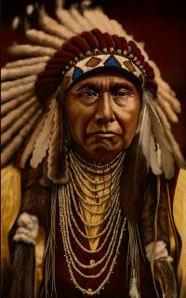
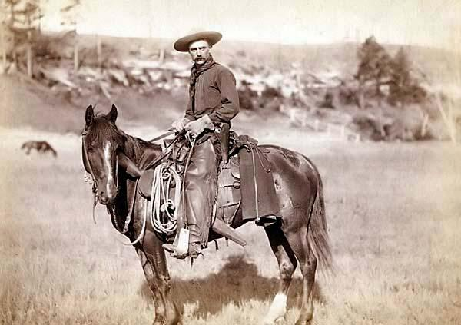
Their attitude to the land was very different too

Slide 6
The Native Americans were treated badly by other Americans including the government. Their way of life was not respected. This led to war.

Slide 7
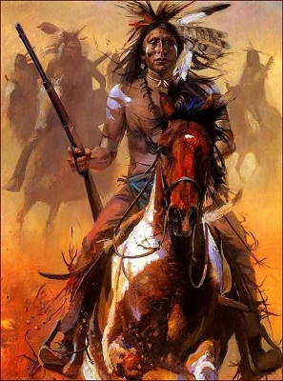
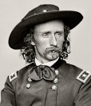
What weapons did the Native Americans and cowboys use?

Slide 8
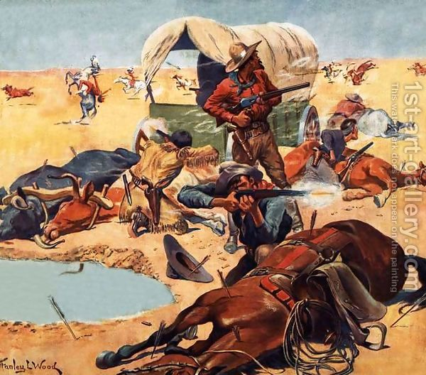
Why do you think the cowboys and the Native Americans fought each other?

Slide 9
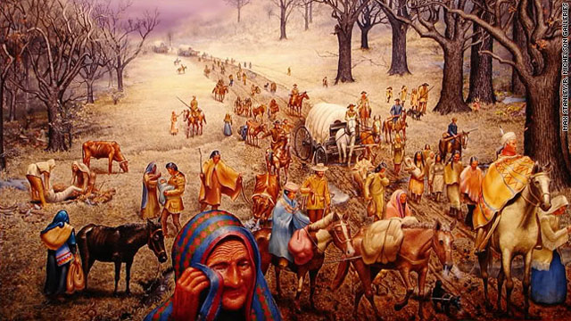
What is happening? Who is it happening to? Why is it happening?

Slide 10
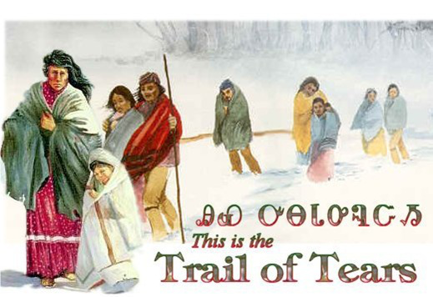
Trail of Tears – do you think the way the Native Americans were treated was fair or unfair? Why?

