Slide 1
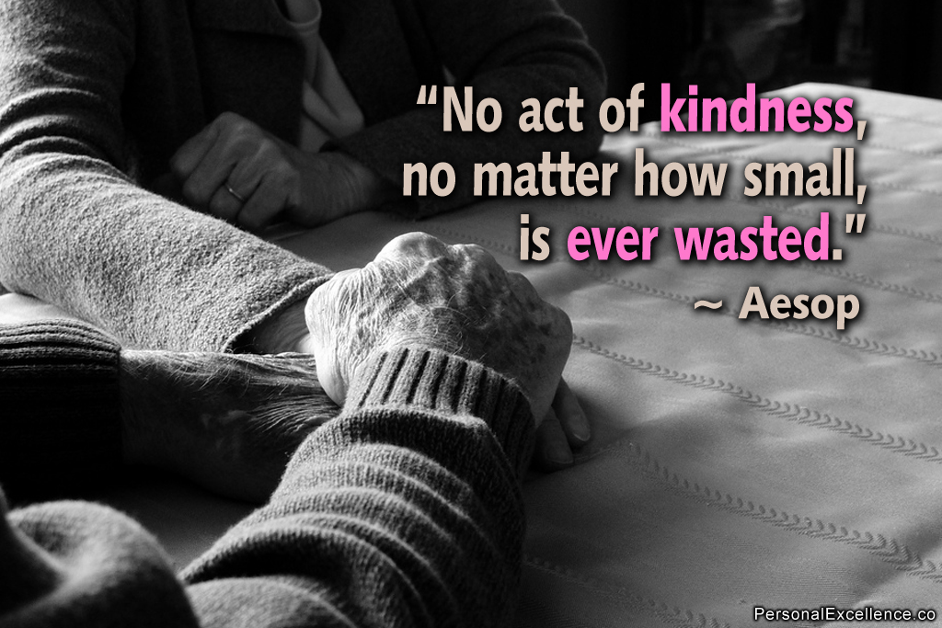
Learning Objectives
We will have analysed the qualities of other learners.
We should have focused on where kindness is important in school.
We could have reflected on how to keep being kind.
Language for Learning: kind
Compliments game: What kind things do you have to say about each other?

Slide 2



We will have analysed the qualities of other learners.
We should have focused on where kindness is important in school.
We could have reflected on how to keep being kind.
WORD MATCH: clever, strong, kind, confident, odd, bully, popular, frightening, helpful, vulnerable, happy, scholarly, simple
Lisa Simpson
Ralph Wiggum
Nelson Muntz

Slide 3
We will have analysed the qualities of other learners.
We should have focused on where kindness is important in school.
We could have reflected on how to keep being kind.
Which of these learners would you call a kind learner? Why?
Which would you like to share a classroom with?
Lisa Simpson
Ralph Wiggum
Nelson Muntz

Slide 4

We will have analysed the qualities of other learners.
We should have focused on where kindness is important in school.
We could have reflected on how to keep being kind.
Ralph is quite a vulnerable learner who would need kindness and help.
Imagine Ralph attends Stone Lodge Academy.
Fill out your case study for all the ways that you could help him around school.
Fill them out with support.
Fill them out independently.
Try to fill them all out.

Slide 5
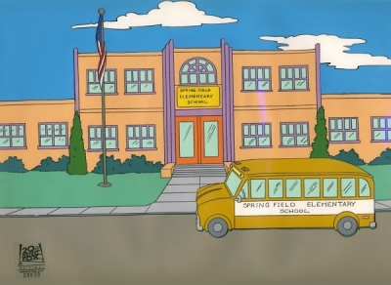
We will have analysed the qualities of other learners.
We should have focused on where kindness is important in school.
We could have reflected on how to keep being kind.
Look at your answers from your case study.
What could you do more of to make school/ home/ public place a kinder place?

Slide 6
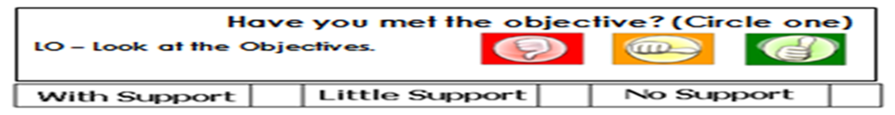
We will have analysed the qualities of other learners.
We should have focused on where kindness is important in school.
We could have reflected on how to keep being kind.
Name: Date:
“Ralph Wiggum: Case Study”
Ralph has… | What would you do?
…fallen over in the playground/ at home/ in public places
… forgotten his lunch money
… talked when you are trying to learn
… split up with his girlfriend
… lost his phone
… come in late for school/ home
… nobody to sit next to in class/ public place

