Slide 2
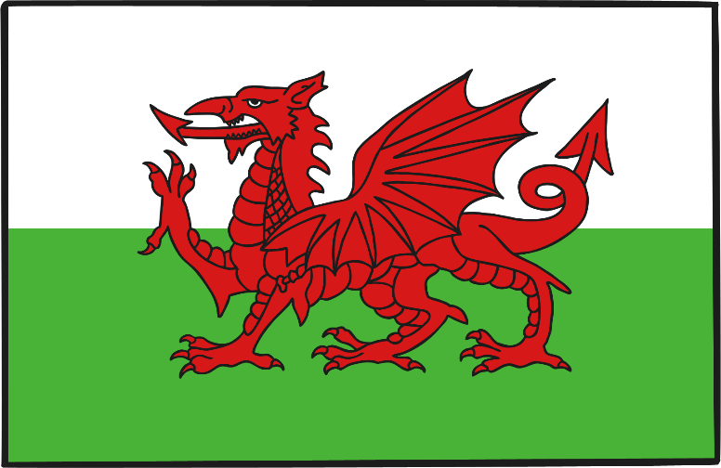
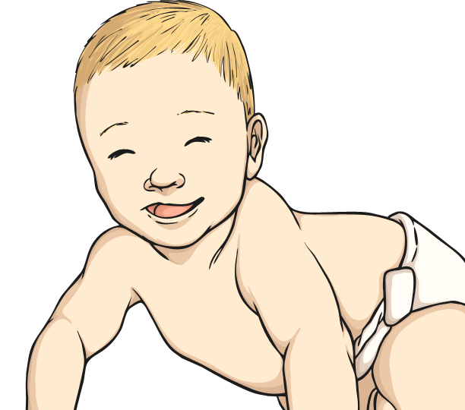
Early Life
Roald Dahl was born on 13th September 1916 in Llandaff, Wales.
His parents were from Norway. He had an older sister called Astri, but she died from meningitis in 1920 when she was only 7. Roald’s father was so sad that he fell ill from pneumonia and also died a few weeks later.
At this time, Roald’s mother was pregnant with her third child, who was born in the autumn. She was called Asta.

Slide 3
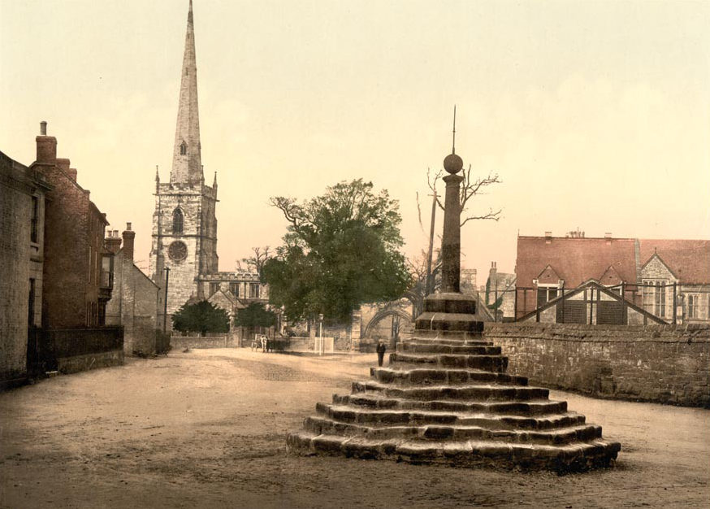
Education
Roald went to school in Wales, but after he had got into trouble too many times, his mother sent him to a boarding school in Weston-Super-Mare.
He later attended Repton Public School in South Derbyshire.
The boys at the school were sometimes asked to be chocolate testers for a famous chocolate company. This experience later inspired the book ‘Charlie and the Chocolate Factory’.
Repton Village
Photo courtesy of (oldeyankee@flickr.com) - granted under creative commons licence – attribution

Slide 4
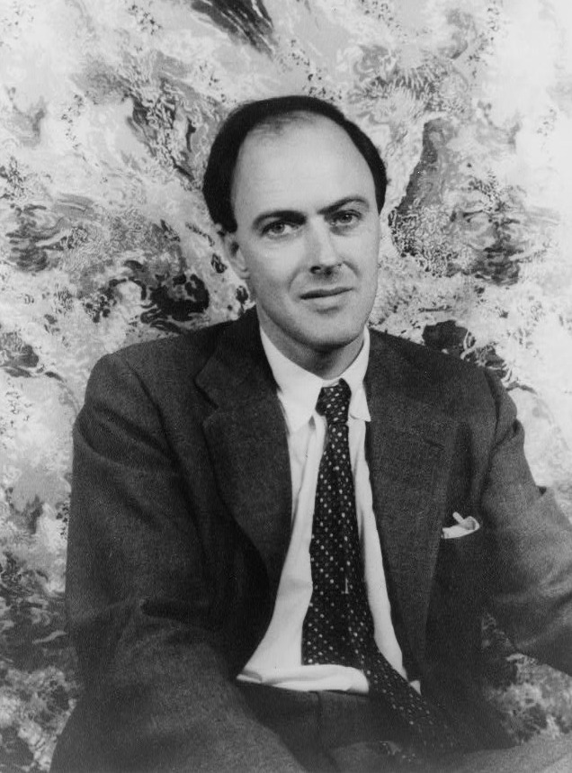
A Young Man
After school, Roald’s mother offered to pay for him to attend Cambridge University, but he wanted adventure.
Roald Dahl
He went on an expedition to Newfoundland, and then joined an oil company so that he could work abroad.
He was sent to Africa for 3 years, but after only one year, the Second World War broke out, so he enlisted with the Royal Air Force and became a pilot.
Photo courtesy of (libraryofcongress@Wikimedia.org)
Granted under creative commons licence – attribution

Slide 5
RAF
Roald Dahl was posted to Libya where he flew a Gloster Gladiator plane. He crashed in the Western desert in North Africa and suffered such severe injuries to his head and back that he had to stay in hospital in Egypt for 6 months.
He returned to the RAF but after a while, he began suffering such terrible headaches from his accident. Therefore, he had to return to the UK and could not fly planes anymore.
Gloster Gladiator
Photo courtesy of (ajw197@flickr.com) - granted under creative commons licence – attribution

