Slide 1
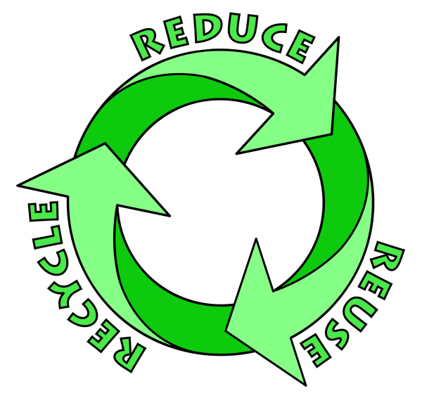
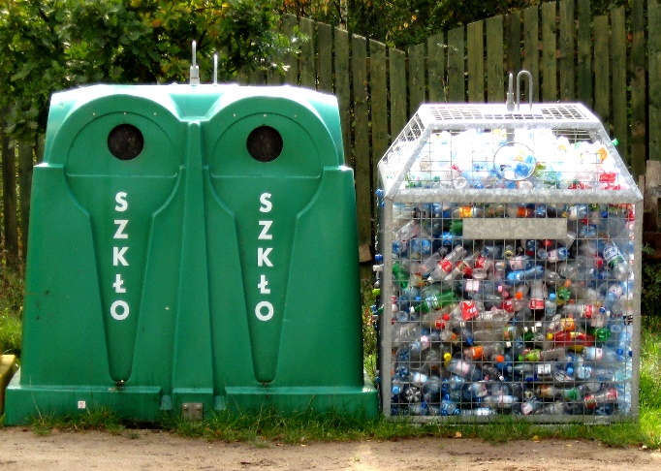
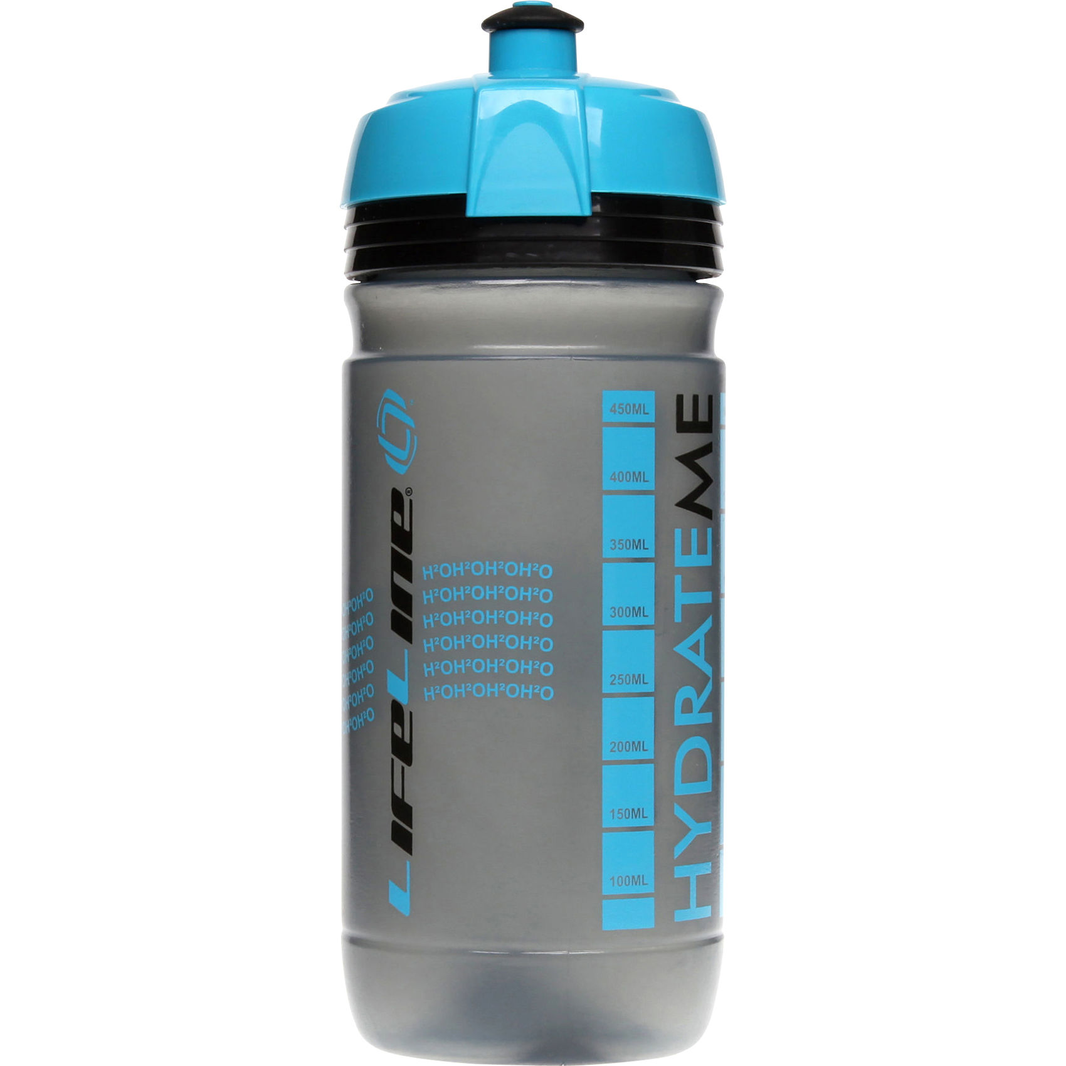
3 Rs
Reduce: to use less of a material when making a product.
Reuse: To use a product over and over again to save on making a new one.
Recycle: To reprocess a material through melting or breaking down in order to make something else.
Which of the 3 Rs does each image apply to?
Which of the 3 Rs does each statement apply to?
 | R
A little sister wears her older sisters clothes instead of buying new ones.
A plastic bottle is melted down and remade as a biro pen.
Easter egg packaging is made less by only using the foil and not the cardboard boxes.
A bag for life is used instead of the free plastic bags given out at the supermarket.
Newspapers are collected at the train station to go back to the newspaper factory.
A plastic tub that a Chinese take away comes in is later used by a school girl to take her pencils to school.
_____________________ _____________________

